Slide 1
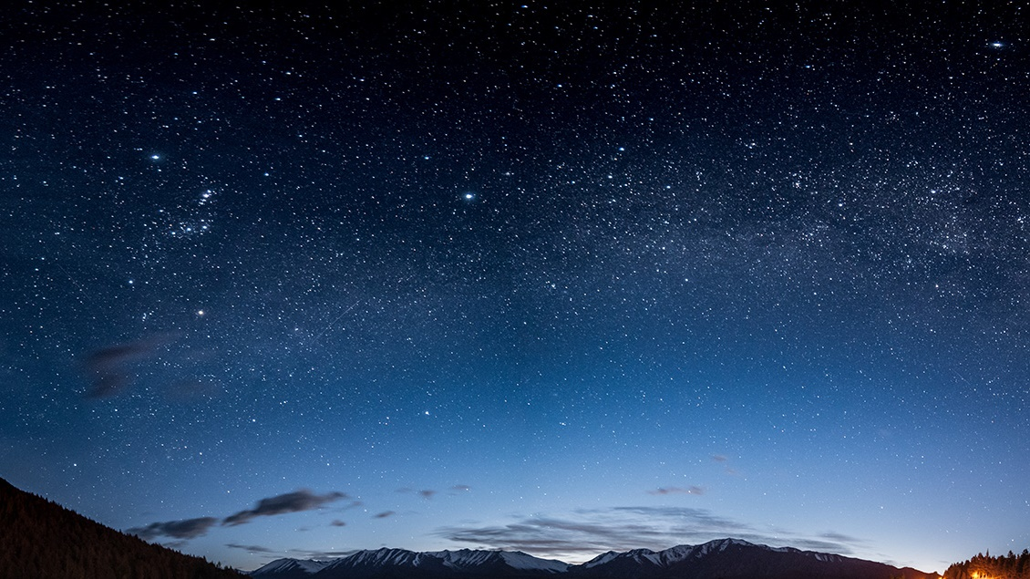
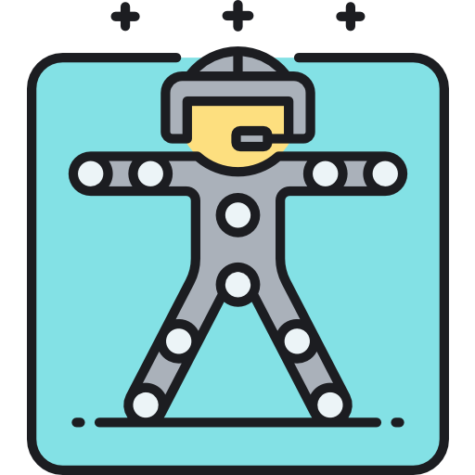
MoveSync
Capture motion. Reveal patterns.

Slide 2
Introduction
What it is & why it matters
Motion capture useful in rehab, sports, and healthcare
❌ Current systems: expensive, complex, and tied to lab setups
✅ Goal: low-cost, low-complex, and browser-based prototype for sport performance analysis
The system combines video (🎥) and IMU sensor (🛜) motion recordings
Synchronization of video and IMU ⟹ qualitative and quantitative view

Slide 3
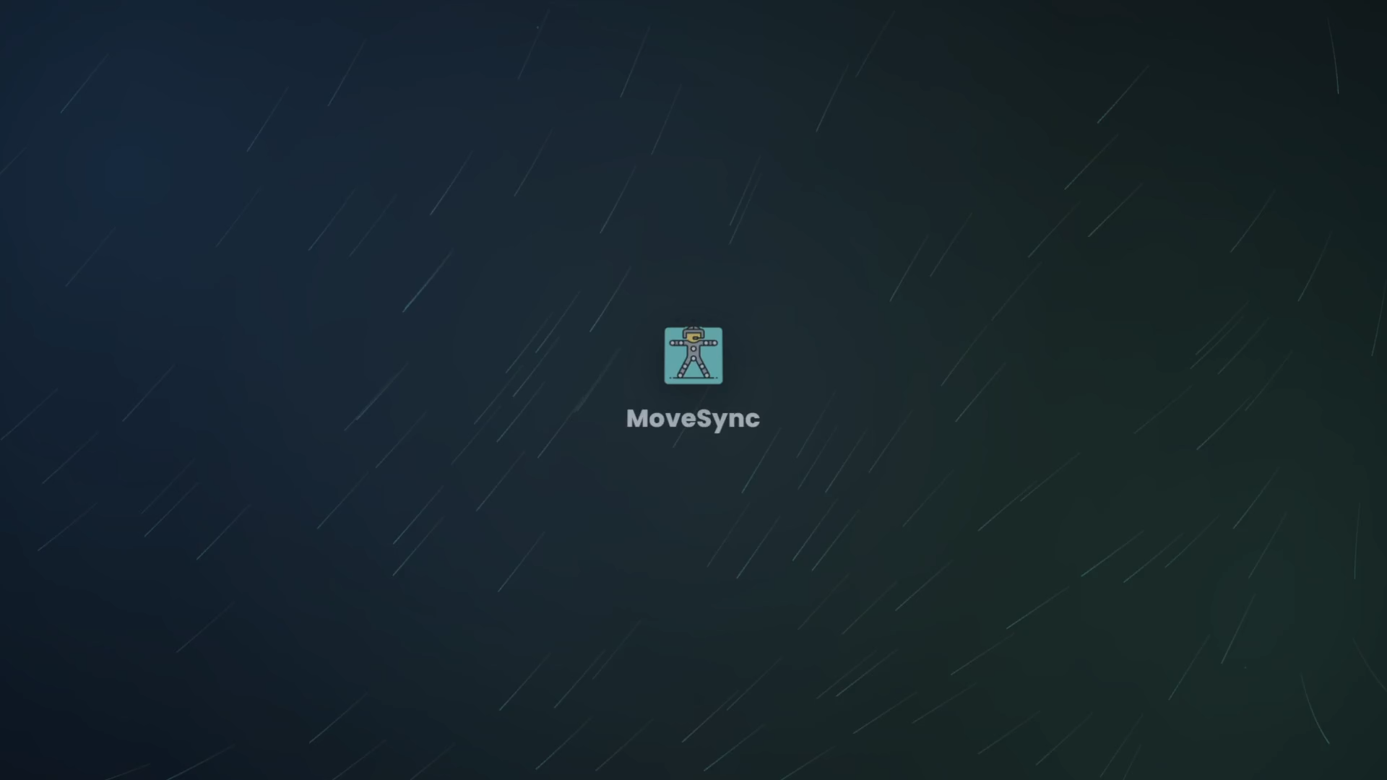
DEMO

Slide 4
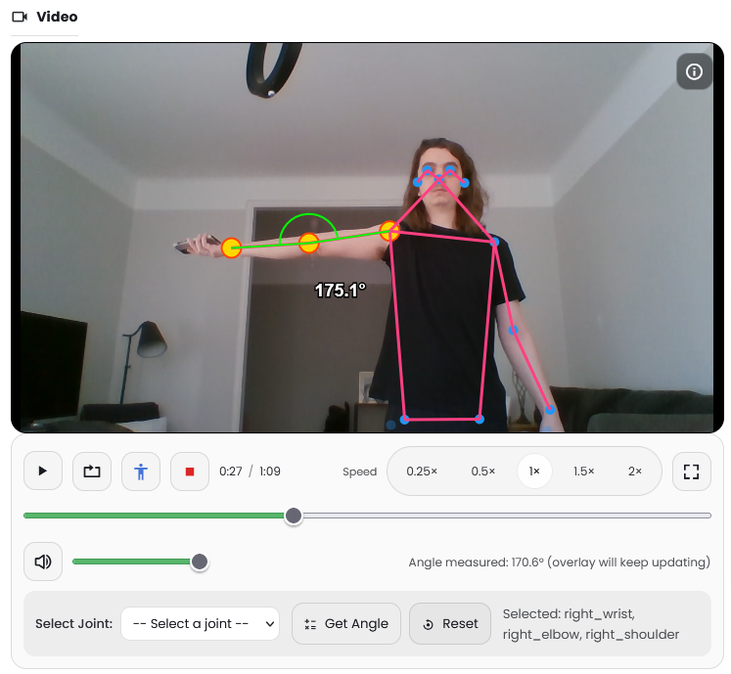
Processing Pipeline – Video Panel
Custom video controls
MoveNet Tracking through Tensorflow.js
17 skeleton nodes
Joint angle live calculations
Runs locally in the browser
Notes:
The core functions of our web application primarily reside in the session viewer page where we have two processes that run side by side.
For the videos, we have a video player here with custom controls to aid with analysis, speed and repeat with the plan to introduce single frame adjustments.
Once you press the button with the little person the skeleton tracking will be initiated. We are using Googles pose estimation model called MoveNet running through TensorFlow
This happens fully locally on the machine requiring no downloads, just an internet connection.
This model detects 17 nodes across the body (primarily at the joints) and overlays them on the video in real time.
Currently this is primarily for observation purposes, but we have built a joint angle calculation tool that takes the positions of selected nodes and calculates and displays the angle formed by them, seen here. This has its limitations due to the pose estimation being 2D but will eventually be used in conjunction with angle calculations from multiple IMU sources.

Slide 5
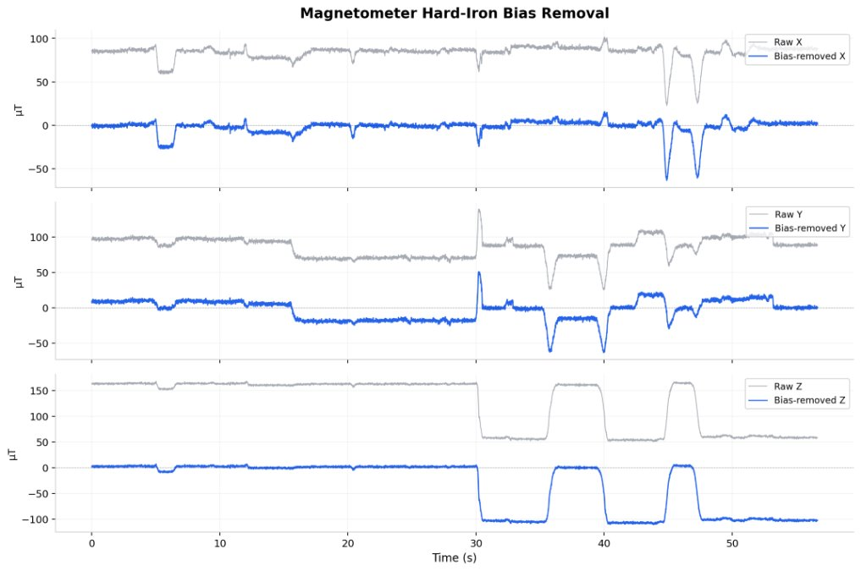
Processing Pipeline – IMU Data
Step 1: Detect Sample Rate/Gyroscope Unit Detection
Sample Rate based on the Median Interval
Gyroscope can be deg/s or rad/s
Step 2: Magnetometer Bias Removal
Median of full data is subtracted
Step 3: Sensor Fusion
Madgwick Algorithm – AHRS Toolbox
Notes:
Regarding the IMU data there are several processing steps that take place upon loading into the session viewer page.
There is the option to view the raw csv data that we require the IMU data to be in the form of but most of the analysis happens after a few key steps.
Part of the goal is to be able to use this webapp with any IMU sensor or data and so it must be able to handle varying sample rates. Thus, the first step is to figure out what the sample rate, which we are calculating based on the median differences between the timestamp values.
Similarly, the units for the gyroscope are checked to confirm if they are in degrees per second or radians per second, based on a 75th percentile threshold of approx. 0.5.
Before moving on to sensor fusion we need to account for the hard iron bias of the IMU sensor. This is a fixed magnetic offset caused by the ferromagnetic material inside the sensor itself, which is large enough relative to the earths magnetic field to significantly influence the raw magnetometer reading, impacting the heading signal.
To remove it, the median of each axis across the entire recording is subtracted from the raw data.
Next, we run the data through the Madgwick algorithm using the AHRS toolbox. This uses the data from each of the accelerometer, gyroscope and magnetometer and produces a quaternion for every sample.
A quaternion is a four-component representation of orientation in 3D space that avoids the gimbal lock problems you get with traditional Euler angles.
Madgwick works by using the accelerometer and magnetometer as stable reference vectors to continuously correct the drift that accumulates in the gyroscope
The filter also has a 50-sample warm-up period at the start since it initialises with no knowledge of orientation and takes a short time to converge, so those first samples are not fully trusted.

Slide 6
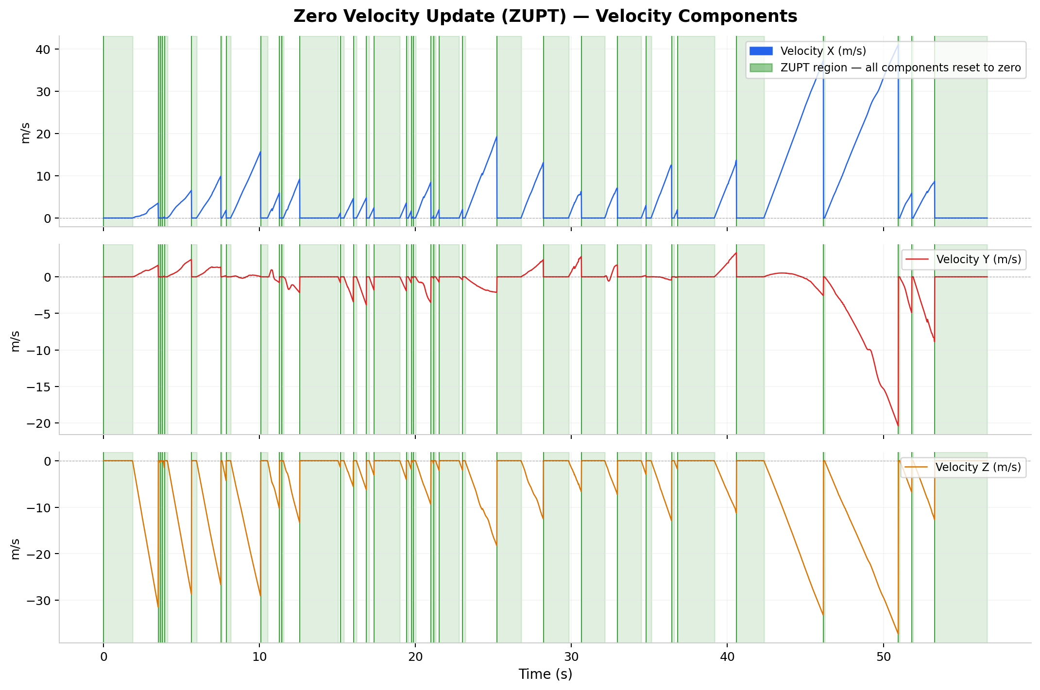
Processing Pipeline – IMU Data
Step 4: Gravity Removal
Quartenion based
Step 5: Zero Velocity Update (ZUPT)
Thresholds:
  <8 deg/s Gyroscope Magnitude
  0.8-1.2G Acceleration
  8 Consecutive Timestamps
Step 6: Low Pass Filter
First Order 20Hz IIR Filter applied to the raw data
Notes:
Once we have quaternions for every sample, we can use these to remove gravity from the acceleration data to isolate linear accelerations.
At every sample we use the conjugate of the quaternion to rotate the known world gravity vector [0,0,1] into the body frame to subtract it from the raw accelerometer data. This is then rotated back into the world frame so that the axes are consistent throughout the recording.
This resulting world-frame linear acceleration is the direct input to the ZUPT integration in the next step, from which velocity and displacement are derived
Zero velocity update is a technique to correct drift in IMUS by detecting when the sensor is stationary.
This is threshold based for which the system currently scans for 8 consecutive samples where the rotation of the gyroscope is below 8 degrees per second, and the acceleration is between 0.8 and 1.2G’s (sitting still with gravity). Each of these points are classified as a ZUPT and at each point the velocity is hard reset to zero.
Between these ZUPT points, trapezoidal integration is used to give us velocity and from that, displacement.
Not all signals go through the full fusion pipeline. Alongside the fusion steps, a 20 Hz low-pass IIR filter is also applied to the raw magnitude signals, removing high frequency noise while preserving all meaningful human motion like running or throwing.

Slide 7
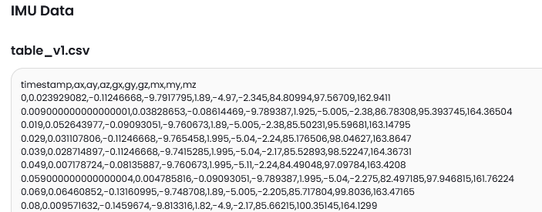
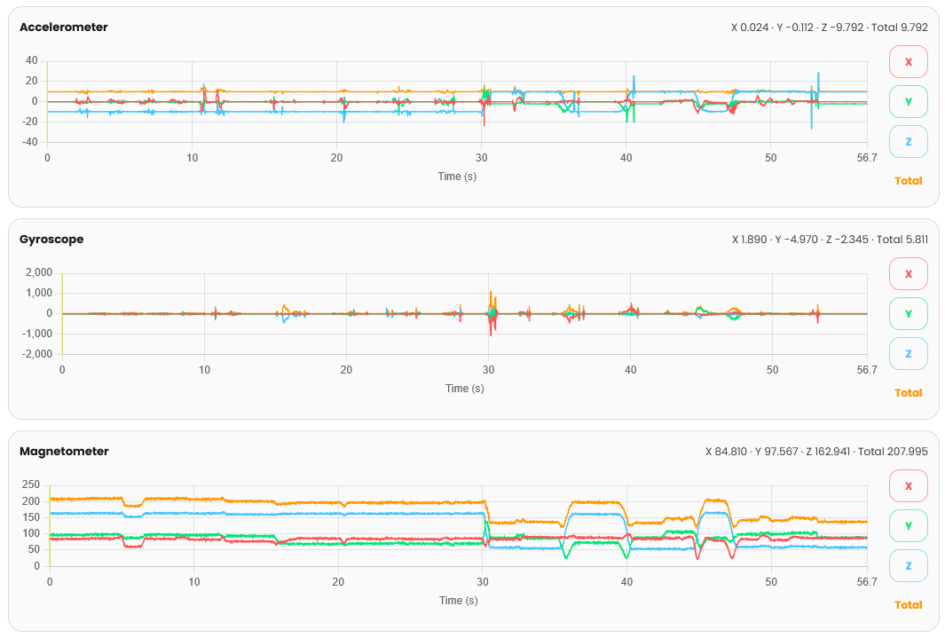
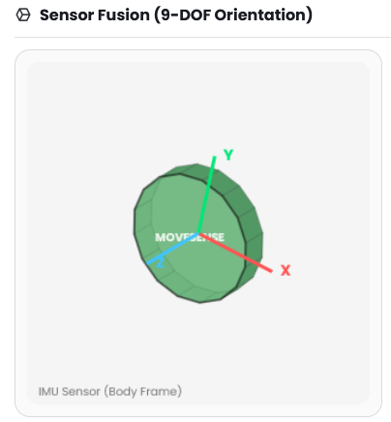
Processing Pipeline – Plotting
Notes:
The output of all these processing steps is then visualised in the IMU graphs tab, which plots the raw and processed signals over time with a cursor synced to video playback, and the sensor fusion 3D tab which shows a 3D model rotating in real time driven directly by the quaternions.
From the IMU data we also calculate and display several metrics to aid with analysis.

Slide 8
Metrics
Acceleration:
  Peak acceleration
  Mean acceleration
  Peak jerk
Velocity and distance:
  Peak velocity
  Mean velocity
  Total distance
Angular velocity:
  Peak angular velocity
  Mean angular velocity
Other:
  Roll and pitch
  Cadence
  Impulse

Slide 9



Metrics - acceleration
Peak acceleration
  Maximum achieved acceleration in terms of magnitude
  Raw acceleration data
  In sports: Injury risk assessment
Mean acceleration
  Arithmetic mean of the magnitude of acceleration
  Raw acceleration data
  In sports: Indicates sustained forceful activity
Peak jerk
  Derivative of acceleration – indicates rate of change in acceleration
  Calculated using central difference
  LP filter is applied to acceleration
  In sports: Predicts injury risk and technique quality

Slide 10


Metrics – Velocity and distance
Peak velocity
  Maximum achieved velocity in terms of magnitude
  Achieved by integrating processed acceleration data
  ZUPT
  In sports: Indicates maximum sprint speed
Mean velocity
  Arithmetic mean of the magnitude of velocity
  Achieved by integrating processed acceleration data
  ZUPT
  In sports: Indicates if performance is consistent
Total distance
  Total ground covered by sensor
  Achieved by integrating velocity data
  In sports: Quantifies work done

Slide 11


Metrics – Angular velocity
Peak angular velocity
  Maximum achieved angular velocity in terms of magnitude
  Raw angular velocity data
  In sports: Fast rotation ---> better outcome (golf, javelin, discus)
Mean angular velocity
  Arithmetic mean of magnitude of angular velocity
  Raw angular velocity data
  In sports: Indicates if performance is consistent (rowing, gymnastics)

Slide 12
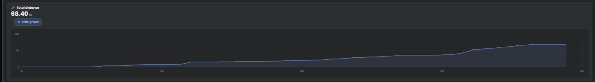
Metrics – validation
Not yet tried to verify metrics
Some metrics are way off --> total distance
More qualitative analysis than quantitative
Still a work in progress

Slide 13
Future Work
Make system more useful in real scenarios:
  improve critical value calculations
  add session comparison
Develop the system as a learning tool
Explore continuation in PCC3 with supervisor
Notes:
Looking at the next steps for MoveSync, there are three main directions.
First, would like to make the system more useful in real scenarios.
A key feature we would like to improve is the critical value calculations. As Alex talked about, when integrating acceleration twice, even small sensor noise can lead to large errors in the final result.
Another key feature we would like to add is the session comparison. This would allow users to compare multiple recordings and identify differences between trials, between users, or over time.
Second, we also see potential to develop MoveSync more as a learning tool, where the most important information is presented in a clear and intuitive way, while still allowing access to more detailed graphs and analysis when needed.
Finally, in PCC3, we will discuss with our supervisor about future improvements and implementations of MoveSync.

Slide 14
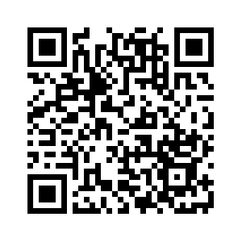
Conclusion
A browser-based motion tracking prototype for sports analysis without requiring specialized equipment.
Future improvements will improve its capabilities.
https://github.com/JHutton8/IMUVideo-Application
Notes:
In conclusion, the current MoveSync system is successfully developed as a browser-based motion tracking prototype for sports performance analysis without requiring specialized equipment.
Future improvements will improve its capabilities.
MoveSync is currently available as open-source through this GitHub link. Feel free to try it out. We appreciate any feedback or suggestions.

Slide 15

THANK you!
sahandkh@kth.se
hutton@kth.se
aledjon2@kth.se

